Slide 1
CourseMate
“I've been on a calendar, but I've never been on time. ” ~Marilyn Monroe

Slide 2
Who are we?
Amrutha Krishnan Binuri Walpitagamage Carl Gledhill Michael Li Sang-Ah Han Tommy Li

Slide 3
What makes us exceptional?
Instructor appointed student admins
Calendar overlay/filtering
Notifications

Slide 4
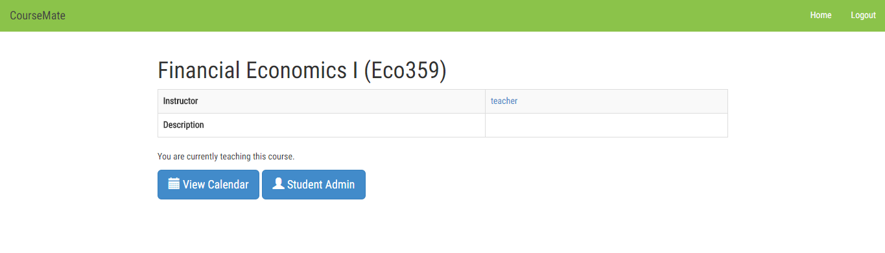
Student Admins
Once navigating to the course page the instructor may select the student admin button

Slide 5
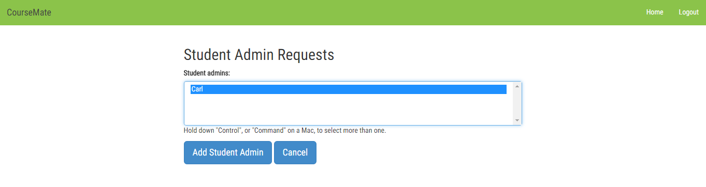
Student Admins
From here, the professor has the ability to choose one or more student delegates to ensure calendar accuracy

Slide 6
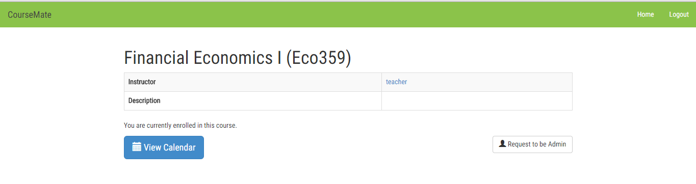
Student Admins
The students also have the ability to request promotion to student admin from their accounts

Slide 7
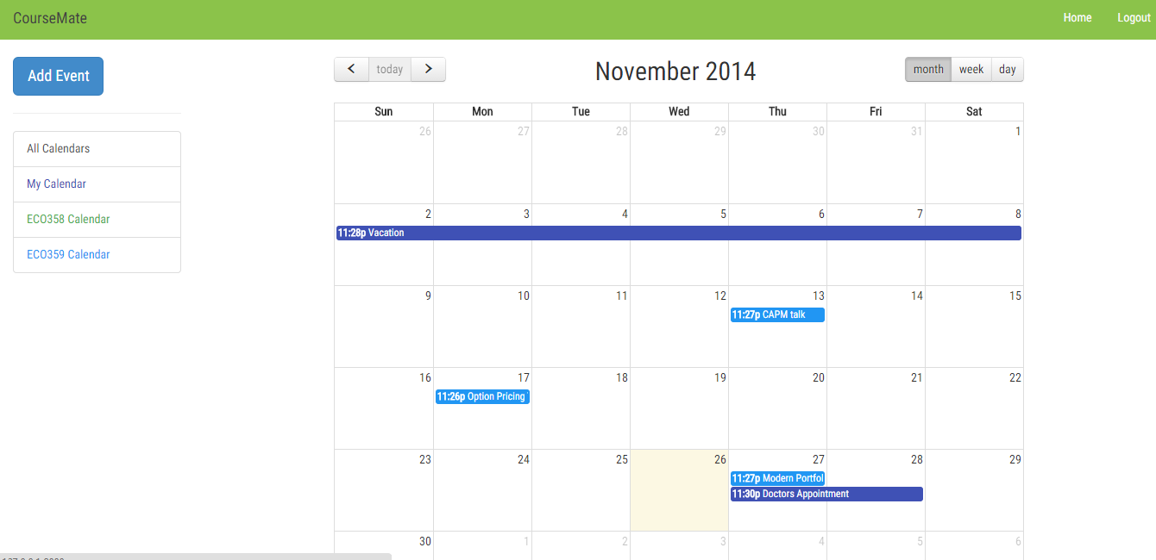
Calendar Overlay / Filtering

Slide 8
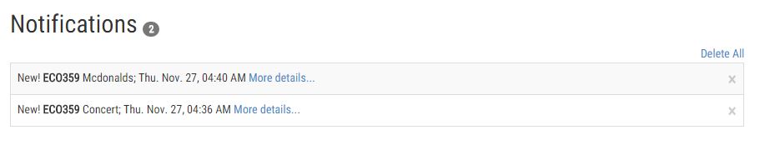
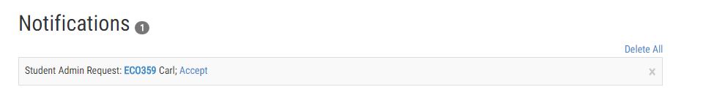
Notifications
New events and student admin requests

Slide 9
Module Components
Users
Creating Students and Instructors + authentication
Scheduler
Creating, viewing, editing Calendars and events
School
Creating, viewing, editing School and Course data
Notifications
Create notifications based on signals received

Slide 10
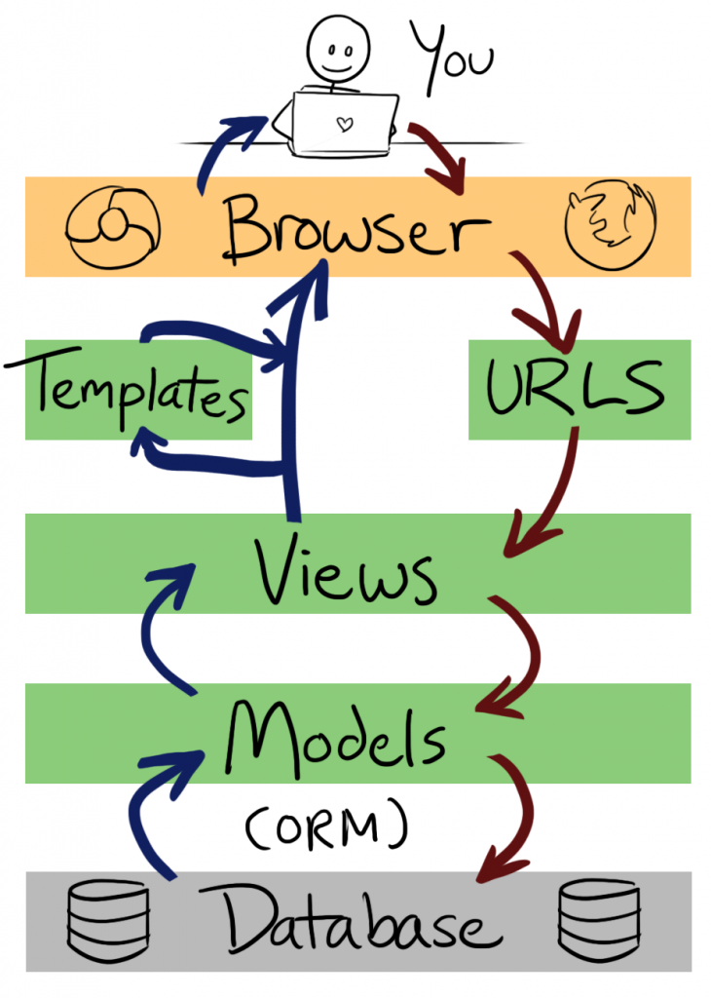
Interactions
Users login (example scenario)
User types URL
Django redirects to view for authentication
Use models to get appropriate data and authenticate the credentials
Pass login status to the template
Load the response in the users browser indicating if the login was successful
(http://littlegreenriver.com/weblog/wp-content/uploads/mtv-diagram-730x1024.png)

Slide 11
Tool Components
Backend : Django, MySQL, Python
Frontend : HTML/CSS, JS, jQuery + JS Libraries (fullcalendar, datetimepicker, list.js)
User Stories and tasks : Github milestones and issues + tags
Communication : Facebook
Notes:
bootstrap jquery list.js full-calendar and django date-time picker (which is technically installed on back end but used for front end)

Slide 12
Techniques
Divided up different aspects of the project into separate apps.
e.g. Scheduler contained the Calendar and Event models.
Used AJAX to get real time notifications
Used MVT design pattern

